Slide 1
Predictive Modeling
Chapter 7: Nonlinear Regression Models
STA 6543
The University of Texas at San Antonio

Slide 2
Overview
Part I: General Strategies
Part II: Regression Models
Chapter 6: Linear Regression and Its Cousins
Chapter 7: Nonlinear Regression Models
Chapter 8: Regression Trees and Rule-Based Models
Part III: Classification Models
Chapter 12: Discriminant Analysis and Other Linear Classification Models
Chapter 13: Nonlinear Classification Models
Chapter 14: Classification Trees and Rule-Based Models

Slide 3
Nonlinear regression models
A motivating example about solubility data
Four types of nonlinear models
Neural Networks
Multivariate Adaptive Regression Splines
Support Vector Machines
K-Nearest Neighbors
R demonstrations

Slide 4
Motivations
In Chapter 6, we learned a number of approaches for modeling the relationship between a response Y and a set of predictors X.
Many of these models can be adapted to nonlinear trends in the data by manually adding terms (e.g., squared terms) with knowing the specific nature of the nonlinearity of the data.
In this chapter, we consider nonlinear regression models without knowing the exact form of the nonlinearity
Neural networks
Multivariate adaptive regression splines (MARS)
Support vector machines (SVMs)
K-nearest neighbors (KNNs)

Slide 5
Neural networks
Chapter 7-Part II Regression Models

Slide 6
Neural networks
The term neural network has evolved to encompass a large class of models and learning methods.
Neural network can be viewed as a multi-stage regression or classification model, typically represented by a network diagram.
We focus the most widely used “vanilla” neural net, sometimes called the single hidden layer back-propagation network, or single layer perceptron.
The central idea is to extract linear combinations of the inputs as derived features, and then model the target as a nonlinear function of these features.

Slide 7
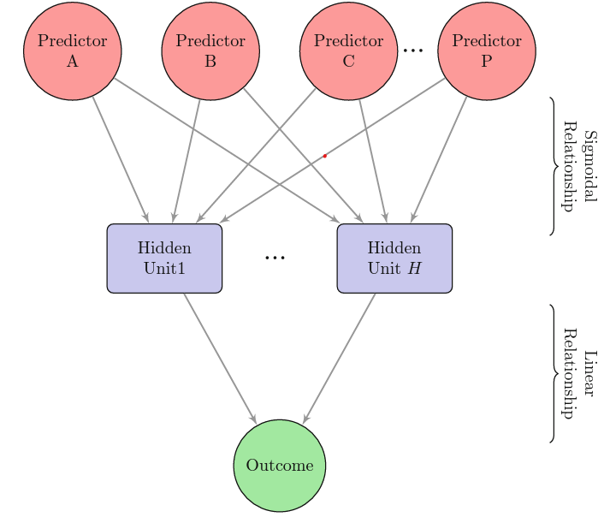
A diagram of a neural network with a single hidden layer.

Slide 8
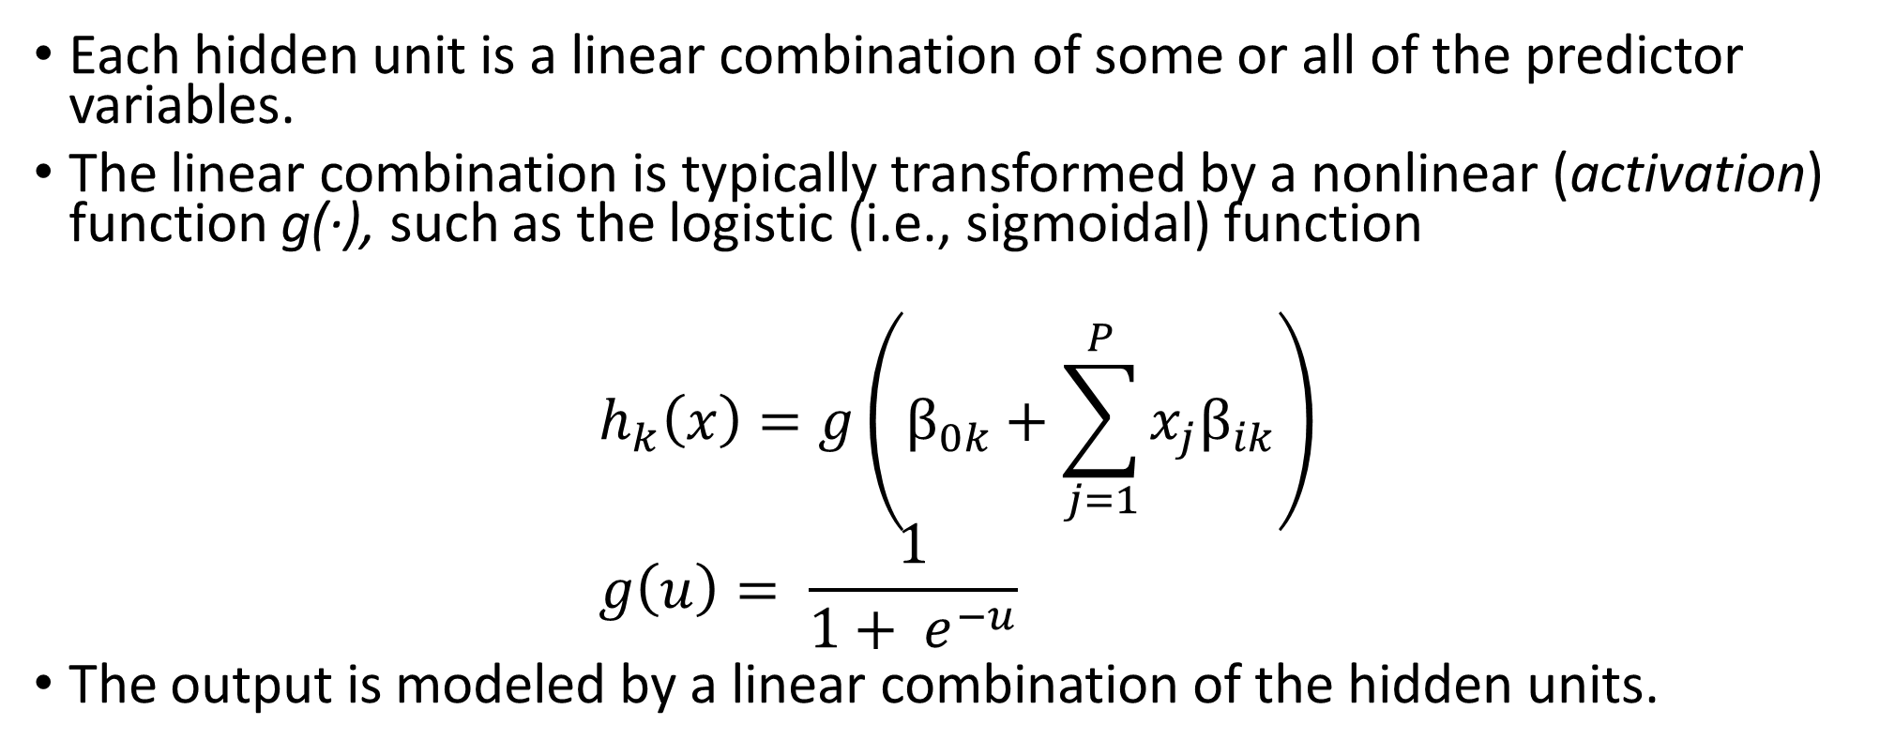
Neural networks
Each hidden unit is a linear combination of some or all of the predictor variables.
The linear combination is typically transformed by a nonlinear (activation) function g(·), such as the logistic (i.e., sigmoidal) function
$$h_{k}\left(x\right)=g\left(β_{0k}+\sum_{j=1}^{P}{x_{j}β_{ik}}\right) \\ g\left(u\right)= \frac{1}{1+ e^{−u}}$$
The output is modeled by a linear combination of the hidden units.

Slide 9
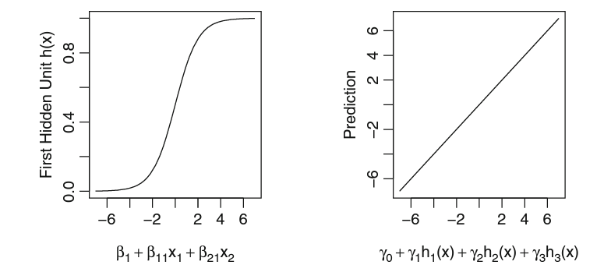
Neural networks
Notice that if g() is the identity function, then the entire model collapses to a linear model in the inputs.
By introducing the nonlinear transformation g(), it greatly enlarges the class of linear models.

Slide 10
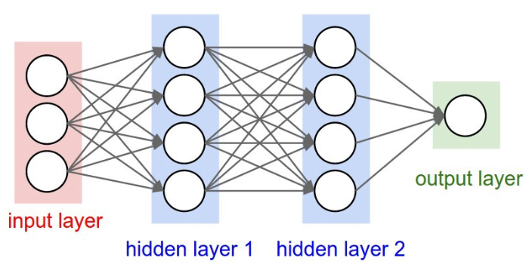
Remarks
The β coefficients are similar to regression coefficients; coefficient β_{jk} is the effect of the jth predictor on the kth hidden unit.
In general, there can be more than one hidden layers.

Slide 11
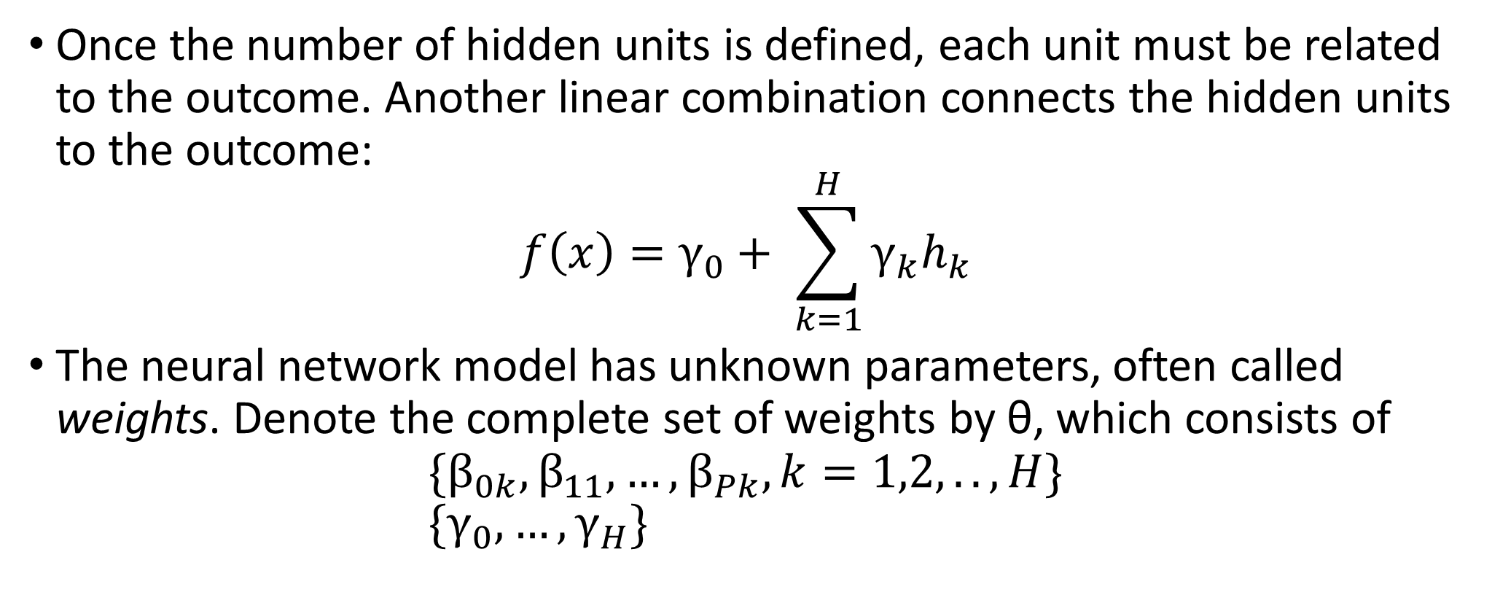
Neural networks
Once the number of hidden units is defined, each unit must be related to the outcome. Another linear combination connects the hidden units to the outcome:
$$f\left(x\right)=γ_{0}+ \sum_{k=1}^{H}{γ_{k}h_{k}}$$
The neural network model has unknown parameters, often called weights. Denote the complete set of weights by θ, which consists of
$${\{β}_{0k},β_{11},…,β_{Pk}, k=1,2,..,H\} \\ \{γ_{0},…,γ_{H}\}$$

Slide 12
Illustration
For this type of network model and P predictors, there are a total of H(P + 1)+H+1 total parameters being estimated, which quickly becomes large as the number of predictors P increases.
For the solubility data, recall that there are P = 228 predictors. A neural network model with three hidden units (H = 3) would estimate 691 parameters while a model with five hidden units (H = 5) would have 1,151 coefficients, which is larger than the sample size n = 951.

Slide 13
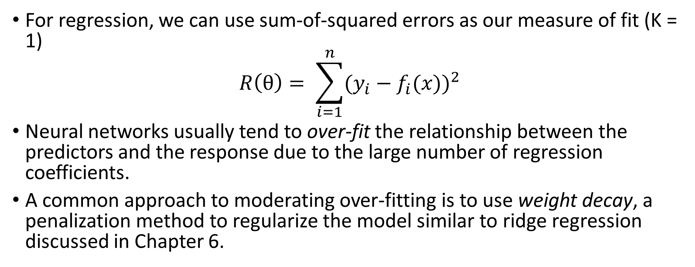
Fitting neural networks
For regression, we can use sum-of-squared errors as our measure of fit (K = 1)
$$R\left(θ\right)= \sum_{i=1}^{n}{{(y_{i}−f_{i}(x))}^{2}}$$
Neural networks usually tend to over-fit the relationship between the predictors and the response due to the large number of regression coefficients.
A common approach to moderating over-fitting is to use weight decay, a penalization method to regularize the model similar to ridge regression discussed in Chapter 6.

Slide 14
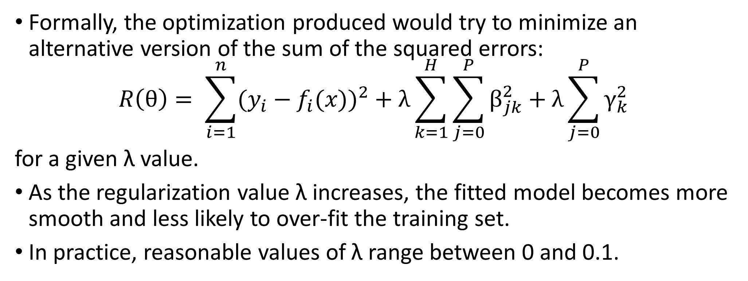
Fitting neural networks
Formally, the optimization produced would try to minimize an alternative version of the sum of the squared errors:
$$R\left(θ\right)= \sum_{i=1}^{n}{{(y_{i}−f_{i}(x))}^{2}}+λ\sum_{k=1}^{H}{\sum_{j=0}^{P}{β_{jk}^{2}}}+λ\sum_{j=0}^{P}{γ_{k}^{2}}$$
for a given λ value.
As the regularization value λ increases, the fitted model becomes more smooth and less likely to over-fit the training set.
In practice, reasonable values of λ range between 0 and 0.1.

Slide 15
Remarks
The predictors should be centered and scaled prior to modeling.
These models are often adversely affected by high correlation among the predictor variables
Pre-filter the predictors to remove the predictors that are associated with high correlations.
Principal component analysis can be used prior to modeling to eliminate correlations
Due to a large number of unknown parameters, the fitted model finds parameter estimates that are locally optimal.
That is, different locally optimal solutions can produce models that are very different but have nearly equivalent performance.
To get stable prediction, model averaging based on several models from different starting values are suggested.

Slide 16
Load the data
#Required packages library(AppliedPredictiveModeling) library(caret) library(earth) ### Load the data data(solubility) ### Create a control function that will be used across models. We ### create the fold assignments explicitly instead of relying on the ### random number seed being set to identical values. set.seed(100) indx <- createFolds(solTrainY, returnTrain = TRUE) ctrl <- trainControl(method = "cv", index = indx)

Slide 17
R codes for neural networks
### Neural Networks #Create a grid for tuning parameters nnetGrid <- expand.grid(decay = c(0, 0.01, .1), size = c(1, 3, 5, 7), bag = FALSE) #It takes time run ##The following codes takes about 6,000 seconds to run in my computer. ## Your running time may be different depending ## on your cpu.

Slide 18
R codes for neural networks
ptm <- proc.time() #takes more than 6,000 seconds to run in my computer set.seed(100) nnetTune <- train(x = solTrainXtrans, y = solTrainY, method = "avNNet", tuneGrid = nnetGrid, trControl = ctrl, preProc = c("center", "scale"), linout = TRUE, trace = FALSE, MaxNWts = 13 * (ncol(solTrainXtrans) + 1) + 13 + 1, maxit = 1000, allowParallel = FALSE) nnetTune proc.time() - ptm ### Stop the clock plot(nnetTune)

Slide 19
R codes for neural networks
#save the predicted values into testResults testResults <- data.frame(obs = solTestY, NNet = predict(nnetTune, solTestXtrans))

Slide 20
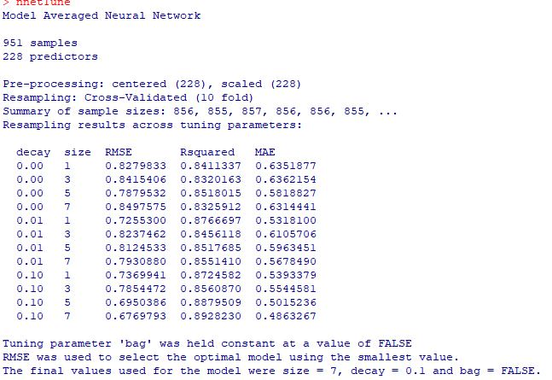
Neural Networks

Slide 21
Neural Networks

Slide 22
Multivariate Adaptive Regression Spline (MARS)
Chapter 7-Part II Regression Models

Slide 23
MARS
MARS is a form of stepwise linear regression, which can be viewed as an extension of linear model that can model non-linearities.
Introduced by Jerome Friedman in 1991.
The term MARS is trademarked and licensed to Salford Systems.
Suitable for higher dimensional inputs.
MARS models are simpler as compared to other models like neural networks or random forest.

Slide 24
Terminology
Multivariate - able to generate model based on several input variables (high dimensionality).
Adaptive - generates flexible models in passes each time adjusting the model.
Regression - estimation of relationship among independent and dependent variables.
Spline - a piecewise defined polynomial function that is smooth (possesses higher order derivatives) where polynomial pieces connect.
Knot (tuning parameter) - the point at which two polynomial pieces connect.

Slide 25
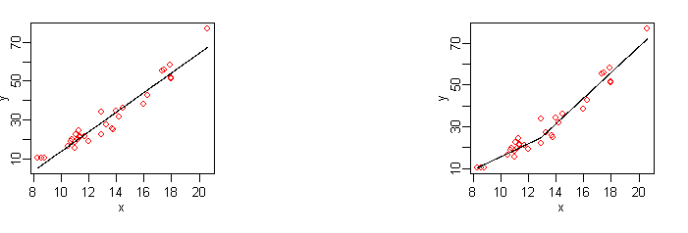
Linear regression vs MARS
Linear regression
MARS

Slide 26
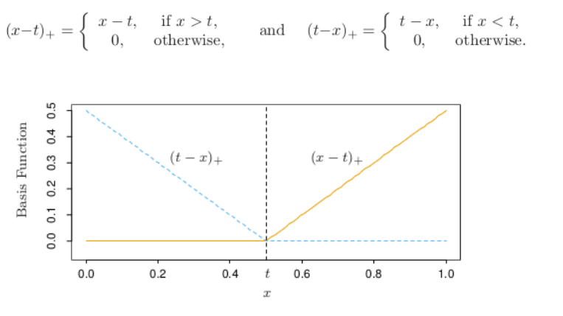
Basis functions
MARS uses piecewise linear basis functions of the form (x-t)₊ and (t-x) ₊. The `+’ means positive part only. So

Slide 27
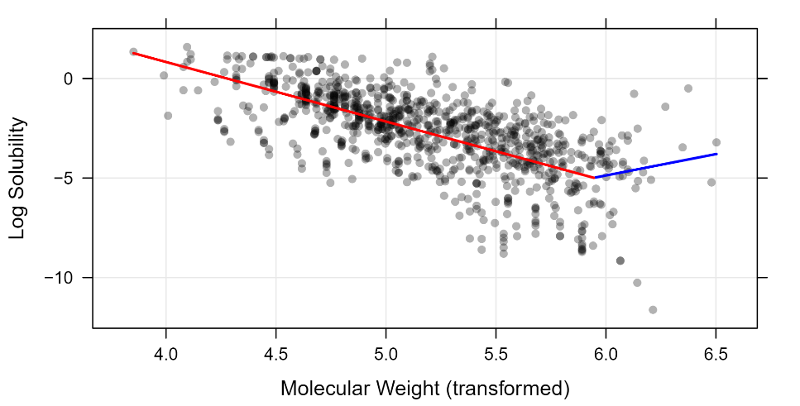
MARS for Molecular Weight in the solubility data
Question: how was the cut point (knot) determined?

Slide 28
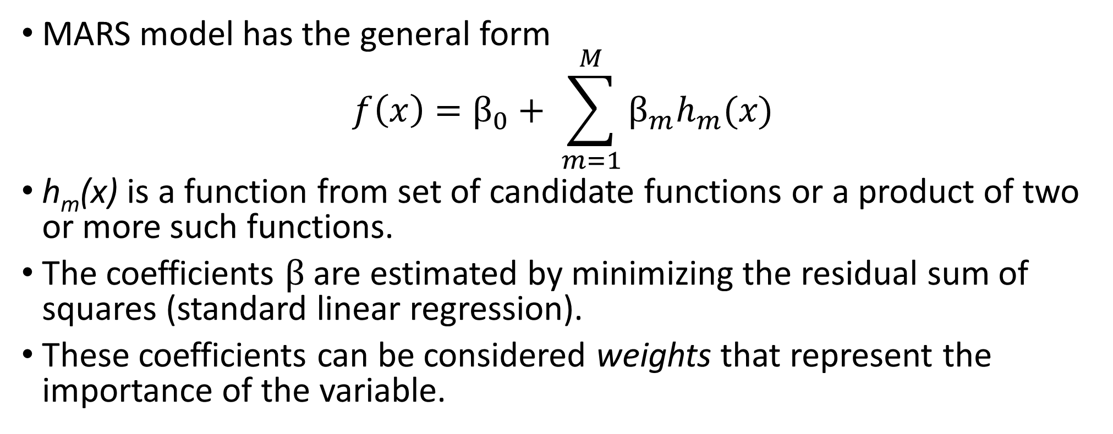
MARS
MARS model has the general form
$$f\left(x\right)=β_{0}+ \sum_{m=1}^{M}{β_{m}h_{m}(x)}$$
h_{m}(x) is a function from set of candidate functions or a product of two or more such functions.
The coefficients $β$ are estimated by minimizing the residual sum of squares (standard linear regression).
These coefficients can be considered weights that represent the importance of the variable.

Slide 29
Remarks
The model automatically conducts feature selection.
The model could quantify the importance of each predictor to the model.
The model provides clear interpretations of how each predictor relates to the outcome.
The model requires very little pre-processing of the data; data transformations, near zero variance, and the filtering of predictors are not needed.
Correlated predictors do not drastically affect model performance, but they can complicate model interpretation.

Slide 30
R codes for MARS
### Multivariate Adaptive Regression Splines ptm <- proc.time() #takes 163 seconds to run in my computer set.seed(100) marsTune <- train(x = solTrainXtrans, y = solTrainY, method = "earth", tuneGrid = expand.grid(degree = 1, nprune = 2:38), trControl = ctrl) marsTune proc.time() – ptm plot(marsTune) #Check the importance of each predictor marsImp <- varImp(marsTune, scale = FALSE) plot(marsImp, top = 25) #save the predicted values into testResults testResults$MARS <- predict(marsTune, solTestXtrans)

Slide 31
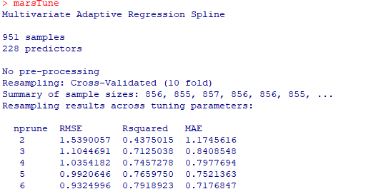
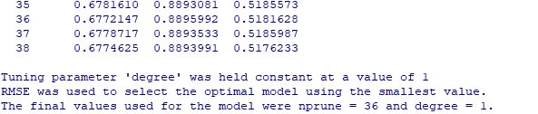
Tuning parameter
.
.
.
.

Slide 32
Tuning parameter

Slide 33
Feature importance

Slide 34
Support vector machines
Chapter 7-Part II Regression Models

Slide 35
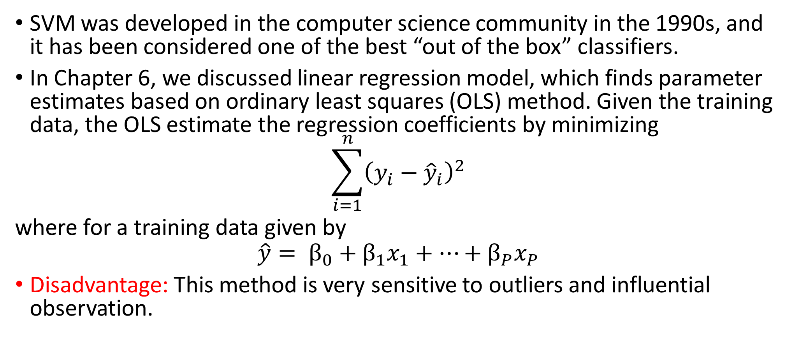
Motivations
SVM was developed in the computer science community in the 1990s, and it has been considered one of the best “out of the box” classifiers.
In Chapter 6, we discussed linear regression model, which finds parameter estimates based on ordinary least squares (OLS) method. Given the training data, the OLS estimate the regression coefficients by minimizing
$$\sum_{i=1}^{n}{{\left(y_{i}−{\hat{y}}_{i}\right)}^{2}}$$
where for a training data given by
$$\hat{y}= β_{0}+β_{1}x_{1}+…+β_{P}x_{P}$$
Disadvantage: This method is very sensitive to outliers and influential observation.

Slide 36
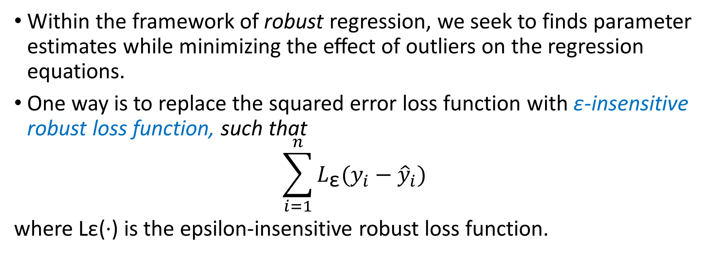
SVM
Within the framework of robust regression, we seek to finds parameter estimates while minimizing the eﬀect of outliers on the regression equations.
One way is to replace the squared error loss function with ε-insensitive robust loss function, such that
$$\sum_{i=1}^{n}{L_{\text{ε}}(y_{i}−{\hat{y}}_{i})}$$
where Lε(·) is the epsilon-insensitive robust loss function.

Slide 37
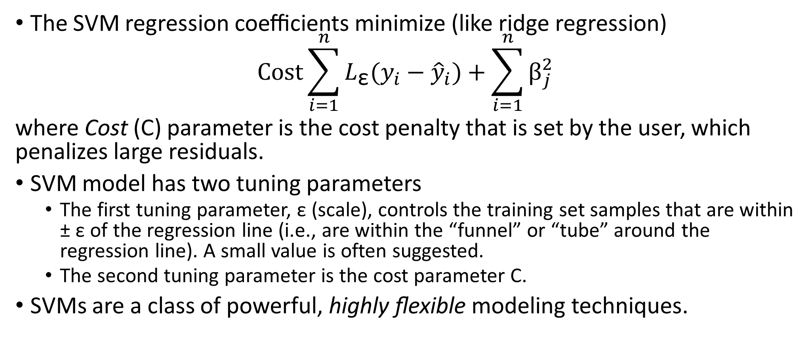
SVM
The SVM regression coeﬃcients minimize (like ridge regression)
$$Cost\sum_{i=1}^{n}{L_{\text{ε}}(y_{i}−{\hat{y}}_{i})}+\sum_{i=1}^{n}{β_{j}^{2}}$$
where Cost (C) parameter is the cost penalty that is set by the user, which penalizes large residuals.
SVM model has two tuning parameters
The first tuning parameter, ε (scale), controls the training set samples that are within ± ε of the regression line (i.e., are within the “funnel” or “tube” around the regression line). A small value is often suggested.
The second tuning parameter is the cost parameter C.
SVMs are a class of powerful, highly ﬂexible modeling techniques.

Slide 38
The cost parameter
C controls the bias-variance trade-off of the SVM
When the cost (C) is large, the model becomes very flexible.
When the cost (C) is small, the model becomes less likely to over-ﬁt (but more likely to under-ﬁt).
In our experience, we have found that the cost parameter provides more ﬂexibility for tuning the model. So, we suggest ﬁxing a value for ε and tuning over the other kernel parameters.
We recommend centering and scaling the predictors prior to building an SVM model.

Slide 39
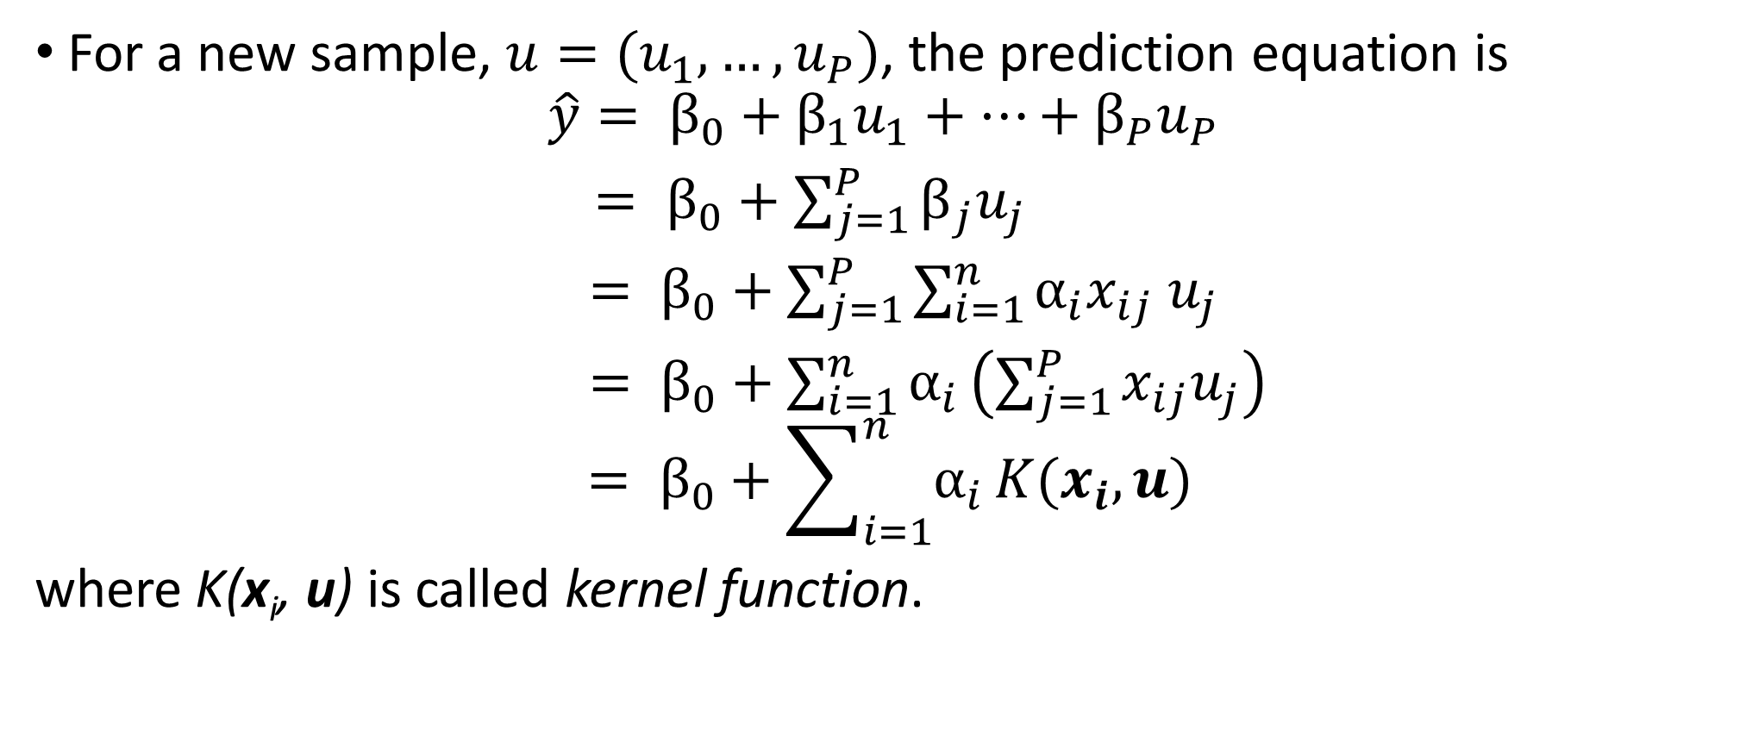
SVM
For a new sample, $u=(u_{1},…,u_{P})$, the prediction equation is
$$\hat{y}= β_{0}+β_{1}u_{1}+…+β_{P}u_{P}$$ $= β_{0}+\sum_{j=1}^{P}{β_{j}u_{j}}$
$= β_{0}+\sum_{j=1}^{P}{\sum_{i=1}^{n}{α_{i}x_{ij}}}$ $u_{j}$
$= β_{0}+\sum_{i=1}^{n}{α_{i}}\left(\sum_{j=1}^{P}{x_{ij}u_{j}}\right)$
$$= β_{0}+\sum_{i=1}^{n}{α_{i}}K(x_{i},u)$$
where K(x_{i}, u) is called kernel function.

Slide 40
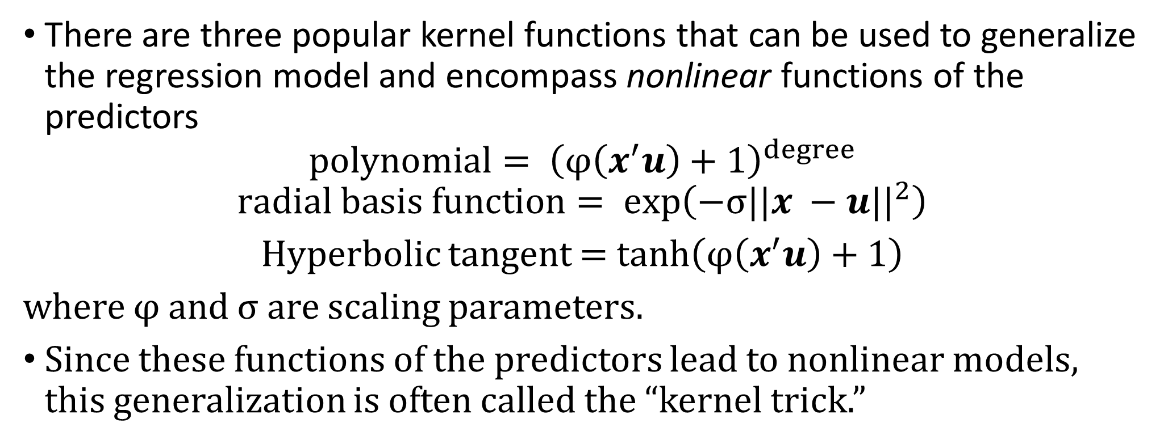
Types of kernel functions
There are three popular kernel functions that can be used to generalize the regression model and encompass nonlinear functions of the predictors
$$polynomial= {\left(φ\left(x^{′}u\right)+1\right)}^{degree}$$
$$radial basis function= exp\left(−{σ||x −u||}^{2}\right)$$
Hyperbolic tangent = tanh$\left(φ\left(x^{′}u\right)+1\right)$
where φ and σ are scaling parameters.
Since these functions of the predictors lead to nonlinear models, this generalization is often called the “kernel trick.”
40

Slide 41
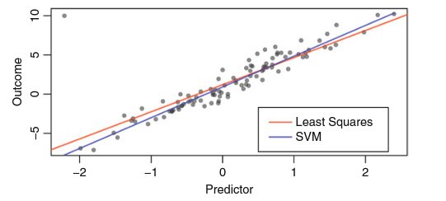
The robustness of the SVM model
A simulated data with a single large outlier. The red line is an ordinary regression line, and the blue line is a radial basis function SVM model.

Slide 42
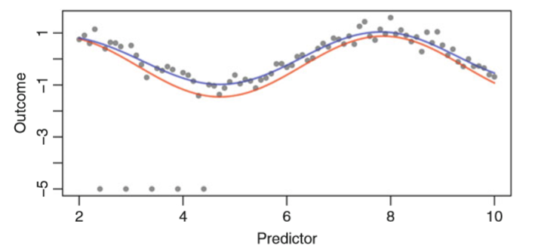
Adaptability to nonlinear relationship
A simulated sin wave with several outliers. The red line is an ordinary regression line (intercept and a term for sin(x)) and the blue line is a radial basis function SVM model.

Slide 43
Remarks
Which kernel function should be used? This depends on the problem.
The radial basis function has been shown to be very eﬀective.
When the regression line is truly linear, the linear kernel function will be a better.

Slide 44
SVM with radial basis function
### Support Vector Machines ## In a recent update to caret, the method to estimate the ## sigma parameter was slightly changed. These results will ## slightly differ from the text for that reason. #SVM with the radial basis function function ptm <- proc.time() # Takes 72.23 seconds in my computer set.seed(100) svmRTune <- train(x = solTrainXtrans, y = solTrainY, method = "svmRadial", preProc = c("center", "scale"), tuneLength = 14, trControl = ctrl) svmRTune proc.time() – ptm plot(svmRTune, scales = list(x = list(log = 2))) ##save the predicted values into testResults testResults$SVMr <- predict(svmRTune, solTestXtrans)

Slide 45
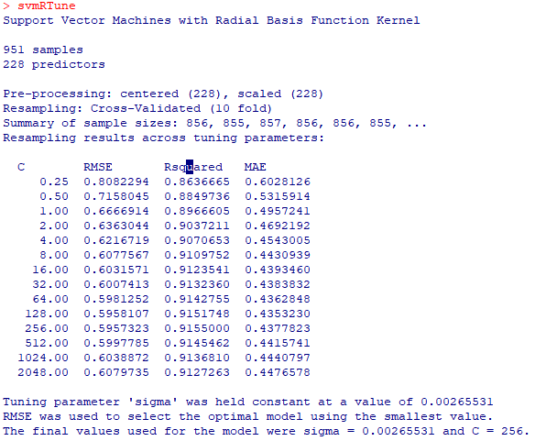

Slide 46
The cost parameter
The cross-validation proﬁles for a radial basis function SVM model applied to the solubility data.

Slide 47
SVM with polynomial
ptm <- proc.time() # takes 313.55 second to run #SVM with the polynomial basis function svmGrid <- expand.grid(degree = 1:2, scale = c(0.01, 0.005, 0.001), C = 2^(-2:5)) set.seed(100) svmPTune <- train(x = solTrainXtrans, y = solTrainY, method = "svmPoly", preProc = c("center", "scale"), tuneGrid = svmGrid, trControl = ctrl) svmPTune proc.time() - ptm plot(svmPTune, scales = list(x = list(log = 2), between = list(x = .5, y = 1))) ##save the predicted values into testResults testResults$SVMp <- predict(svmPTune, solTestXtrans)

Slide 48
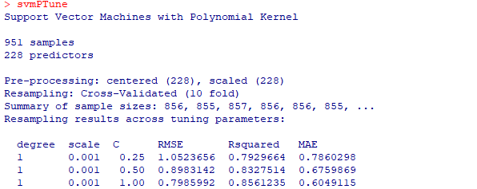

Tuning parameters
.
.
.
.

Slide 49
The cost parameter

Slide 50
K-Nearest neighbors
Chapter 7-Part II Regression Models

Slide 51
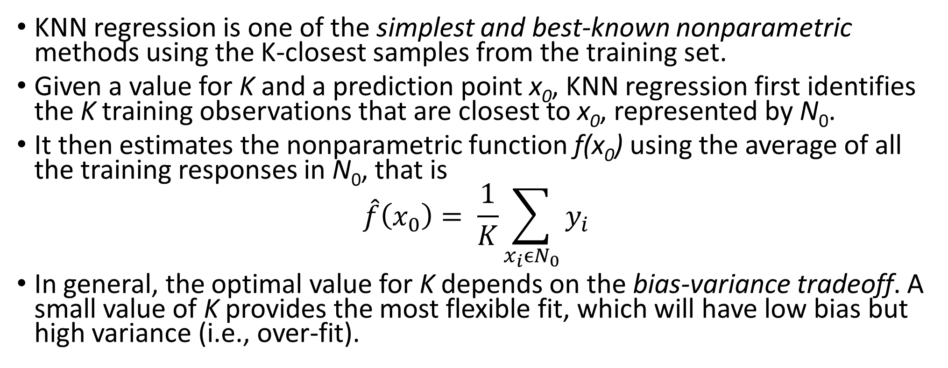
K-Nearest Neighbors (KNN) regression
KNN regression is one of the simplest and best-known nonparametric methods using the K-closest samples from the training set.
Given a value for K and a prediction point x₀, KNN regression first identifies the K training observations that are closest to x₀, represented by N₀.
It then estimates the nonparametric function f(x₀) using the average of all the training responses in N₀, that is
$$\hat{f}\left(x_{0}\right)= \frac{1}{K}\sum_{x_{i}{ϵN}_{0}}{y_{i}}$$
In general, the optimal value for K depends on the bias-variance tradeoff. A small value of K provides the most flexible fit, which will have low bias but high variance (i.e., over-fit).

Slide 52
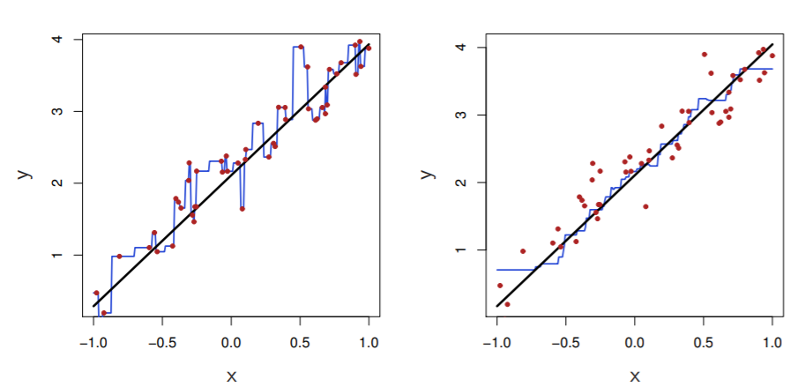
KNN fits for K = 1 and K = 9 one-dimensional data
The tuning parameter K can be determined by resampling.

Slide 53
K-Nearest Neighbors
### K-Nearest Neighbors ### First we remove near-zero variance predictors knnDescr <- solTrainXtrans[, -nearZeroVar(solTrainXtrans)] ptm <- proc.time() # takes 39.86 seconds to run set.seed(100) knnTune <- train(x = knnDescr, y = solTrainY, method = "knn", preProc = c("center", "scale"), tuneGrid = data.frame(k = 1:20), trControl = ctrl) knnTune proc.time() - ptm plot(knnTune) testResults$Knn <- predict(knnTune, solTestXtrans[, names(knnDescr)])

Slide 54
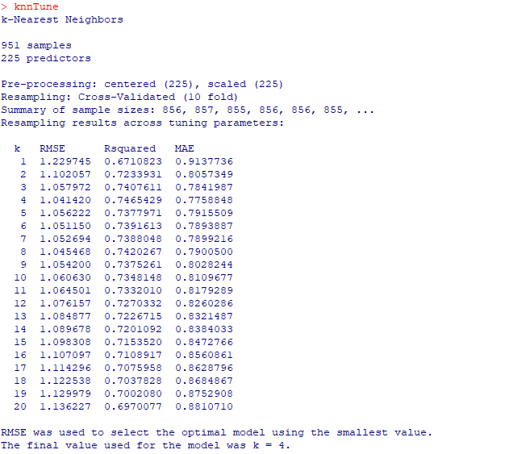
The tuning parameter K

Slide 55
The tuning parameter K
The RMSE cross-validation proﬁle for a KNN model applied to the solubility data. The optimal number of neighbors is 4

Slide 56
Linear regression vs. KNN
The linear regression outperforms KNN if the true form of f is close to linear.
KNN outperforms the linear regression if the true form of f is strongly non-linear.
In higher dimensions, say, p ≥ 4, KNN often performs worse than linear regression due to curse of dimensionality of KNN.
A general rule: Parametric methods will tend to outperform nonparametric approaches when there is a small number of observations per predictor.

Slide 57
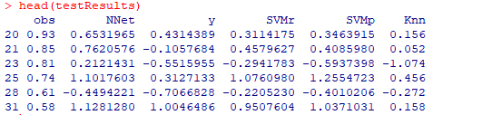
Predicted values based on different models
#print out the predicted values based on different models head(testResults)

Slide 58
Performance comparison of nonlinear models
#Performance of nonlinear models set.seed(100) Nnet.pred = predict(nnetTune, solTestXtrans) MARS.pred <- predict(marsTune, solTestXtrans) SVMr.pred <- predict(svmRTune, solTestXtrans) SVMp.pred <- predict(svmPTune, solTestXtrans) Knn.pred <- predict(knnTune, solTestXtrans[, names(knnDescr)]) data.frame(rbind(NNET=postResample(pred=Nnet.pred,obs = solTestY), MARS=postResample(pred=MARS.pred ,obs = solTestY), SVMr=postResample(pred=SVMr.pred,obs = solTestY), SVMp=postResample(pred=SVMp.pred,obs = solTestY), KNN=postResample(pred=Knn.pred,obs = solTestY) ))

Slide 59

Performance comparison of nonlinear models

Slide 60

Introduction to R
Exercise 4

